Slide 1

Borland Application
Performance Test POC Report
Borland
Project Manager: Jagadeesh
Prepared By: P.L.Raju
Version :0.1
Publish Date :26 Feb 2019

Slide 2
Tool Details
Tool: Load Runner Details:
Load Runner :12.60
Protocol : Single Protocol Web (HTTP/HTML)
Controller : Trial Version
Tool: Meter Details:
Apache Jmeter:5.1
Tool: NeoLoad Details:
NeoLoad : 6.5

Slide 3
Agenda
Performance Testing Overview
  Key Objective
  Key Scenarios and objective of each scenario
  Approach/Success criteria
Results & Findings
  Results
  Key observations
Script

Slide 4
Performance Testing Overview
Key objective
Overall objective of the Borland Application Performance testing is to test the behavior of the application performance testing to ensure that it meet the defined performance objectives as well as scalability, availability of the application

Slide 5
Key Scenarios and objective of each scenario
Business process | No. Of Users | Business Flow
Launch Application | 1 | Borland_S01_SearchByLocation Borland_S02_SearchByAgentName Borland_S03_ShowAllAgents Borland_S04_Account

Slide 6
Test Approach and Success Criteria
Approach
  Start the Load Test with running 1 user load
  Success Criteria
  Able to capture the application with Web (HTTP/HTML) and Execute.

Slide 7
Test Results & Graph

Slide 8
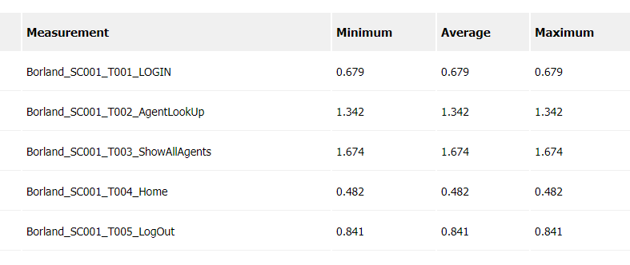
Test Results along with Response Times

Slide 9
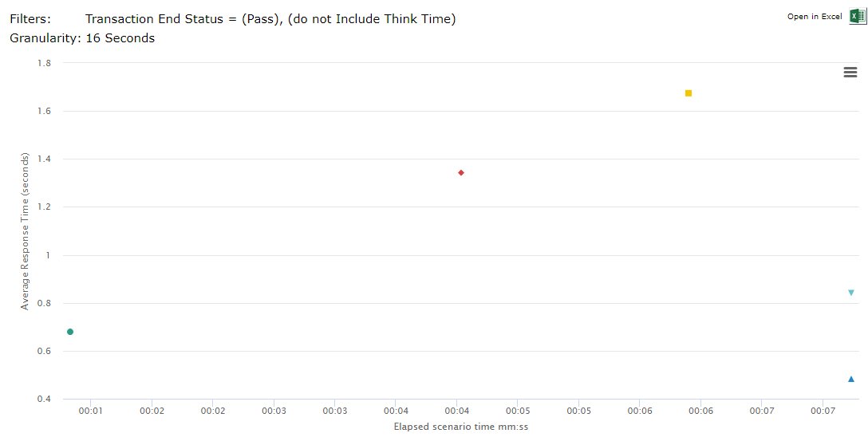
Transaction Response Time Graph

Slide 10
Observations
Tools Compatible:
Load Runner is compatible with this Application
Able to record with Web Http/Html Protocol.
JMeter is not compatible.
NeoLoad is not compatible.

Slide 11


  Script

